Slide 1
Digital Portfolio
STUDENT NAME: MITHUN RAJ.S
REGISTER NO AND NMID:2426J1523 & asbruaz2426j1523
DEPARTMENT: B.Sc. Information Teachnology
COLLEGE/ UNIVERSITY: KPR College of Arts Science and Research /
Bharathiar University

Slide 2
PROJECT TITLE
AI-Powered Portfolio

Slide 3
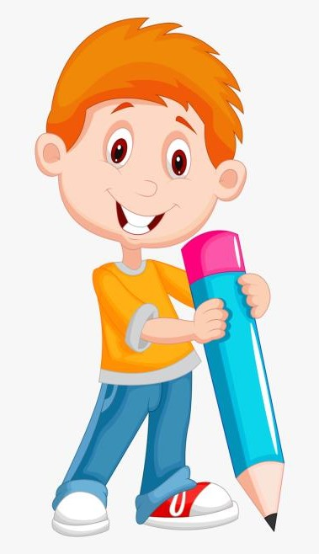

AGENDA
Problem Statement
Project Overview
End Users
Tools and Technologies
Portfolio design and Layout
Features and Functionality
Results and Screenshots
Conclusion
Github Link
3/21/2024 Annual Review

Slide 4

PROBLEM STATEMENT
In today’s competitive job market, a traditional portfolio often presents information in a static format, requiring recruiters or visitors to manually search through sections to find relevant details. This reduces engagement and makes the experience less interactive.
There is a need for a dynamic and intelligent portfolio system that not only showcases an individual’s skills, education, and projects but also allows visitors to interact in real time. By integrating a chatbot assistant, users can quickly obtain personalized answers to questions such as “Tell me about your skills” or “What projects have you worked on?”—making the portfolio more engaging, accessible, and user-friendly.

Slide 5

PROJECT OVERVIEW
The AI-Powered Portfolio with Chatbot is an interactive personal portfolio website designed to present an individual’s professional profile, skills, education, and projects in an engaging way. Unlike traditional portfolios that provide static information, this project integrates a chatbot assistant to make the portfolio more dynamic and user-friendly.
The chatbot acts as a virtual guide, allowing visitors to ask questions such as “What are your skills?”, “Tell me about your education”, or “How can I contact you?”. The chatbot then responds with predefined answers or intelligent replies, ensuring that recruiters, employers, or collaborators can easily access the most relevant details without browsing through multiple pages.
This solution not only improves user engagement but also demonstrates the candidate’s knowledge of web development, JavaScript, and basic AI concepts. The project can later be extended by connecting the chatbot to real AI services like Dialogflow, Rasa, or OpenAI API for advanced conversational abilities.

Slide 6

WHO ARE THE END USERS?
Recruiters / Hiring Managers
Can quickly learn about the candidate’s skills, education, and projects.
Saves time by asking direct questions instead of browsing through pages.
College Professors / Project Evaluators
Can assess the student’s technical ability, creativity, and presentation skills.
Provides a more engaging way to demonstrate a project.
Peers and Collaborators
Fellow students, friends, or colleagues who want to know about the candidate’s expertise for collaboration.
Helps in networking and forming project teams.
General Visitors / Professionals
Anyone who wants to explore the candidate’s background or contact them for opportunities.
Makes the portfolio feel professional and interactive.

Slide 7

TOOLS AND TECHNIQUES
Frontend Development
HTML5 → Structure of the portfolio web pages.
CSS3 → Styling, responsive design, and layout.
JavaScript (ES6) → Core scripting for interactivity and chatbot functionality.
Bootstrap / Tailwind CSS (optional) → To create a modern and responsive design quickly.
🔹 Chatbot Development
JavaScript (Rule-based FAQ) → Initial chatbot logic with predefined responses.
JSON / Object Mapping → For storing chatbot Q&A pairs.
(Optional for future upgrade):
Dialogflow (Google) or Rasa → For NLP-based chatbot.
OpenAI API → For intelligent conversational responses.
🔹 Development Tools
VS Code → Code editor for writing and debugging.
Git & GitHub → Version control and project hosting.
Chrome DevTools → For testing and debugging the website.
🔹 Deployment
GitHub Pages / Netlify / Vercel → Hosting the portfolio online.
(Optional) Firebase / AWS / Heroku → For advanced hosting and chatbot backend integration.

Slide 8
PORTFOLIO DESIGN AND LAYOUT
Overall Design Approach
Clean, modern UI with a minimalistic style.
Responsive design that works well on desktop, tablet, and mobile.
Consistent color theme (e.g., blue + white + grey or any personal brand colors).
Smooth navigation with a clear section-based layout.
Layout Structure
Header / Navigation Bar
Contains links to main sections (Home, About, Skills, Projects, Contact).
Fixed at the top for easy access.
Hero Section (Home Page)
A professional profile picture or avatar.
Your name, title (e.g., "B.Sc. IT Student | Web Developer"), and a short tagline.
A Call-to-Action button (e.g., “Explore My Work” or “Chat with Me”).
About Me Section
Short introduction about you , 2Education background, interests, and career goals.
4.Skills Section
Displayed as skill cards or progress bars/charts (e.g., HTML – 80%, Python – 70%).
Categorized into Programming Languages, Web Development, Tools.
8

Slide 9
FEATURES
Portfolio Features
Interactive Homepage
Clean design with profile picture, name, tagline, and quick navigation.
About Me Section
Personal introduction with education, interests, and career goals.
Skills Showcase
Skills displayed using progress bars, charts, or cards.
Categorized into Programming, Web Development, Tools & Technologies.
Projects Section
Each project displayed as a card/grid with description, screenshot, and GitHub/demo link.
Contact Section
Provides email, LinkedIn, GitHub, and optional contact form.
Responsive Design
Works seamlessly on desktop, tablet, and mobile devices.

Slide 10
FUNCTIONALITY
Floating Chatbot Widget
Available at bottom-right of every page.
Expands into a chat window when clicked.
FAQ-based Responses
Answers predefined questions like:
“Tell me about your skills”
“What projects have you worked on?”
“How can I contact you?”
User-friendly Interaction
Chat-like interface with user messages on the right and bot responses on the left.
Customizable Knowledge Base
Easily add new Q&A pairs inside the chatbot script.
Future Scalability
Can be integrated with AI/NLP tools (Dialogflow, Rasa, or OpenAI API) for smart, human-like responses.

Slide 11
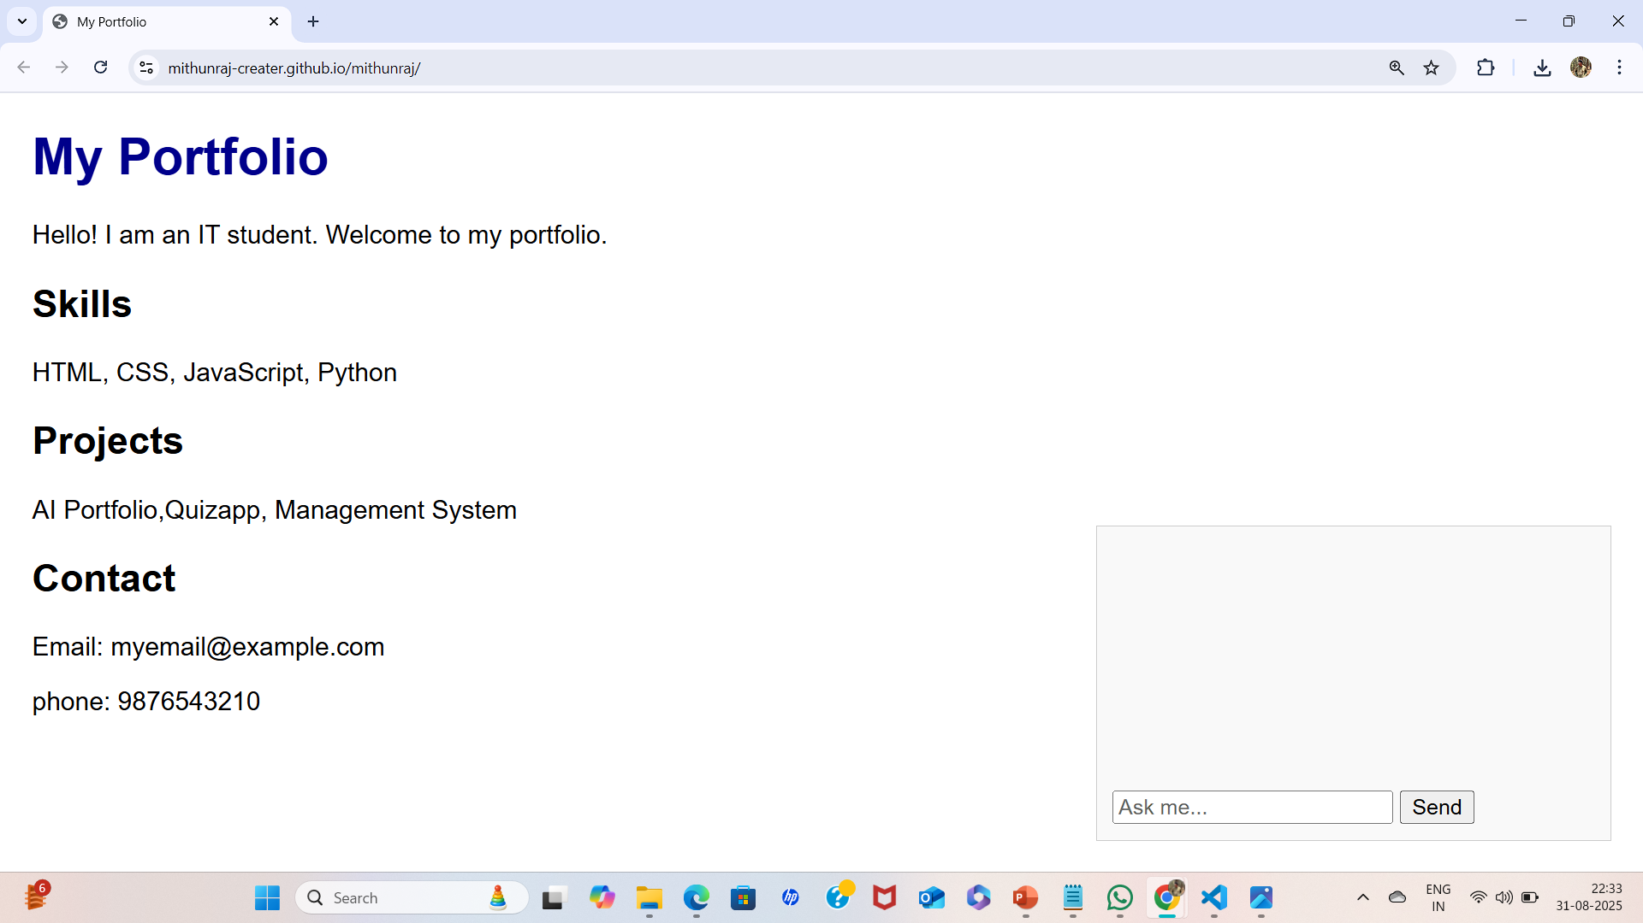
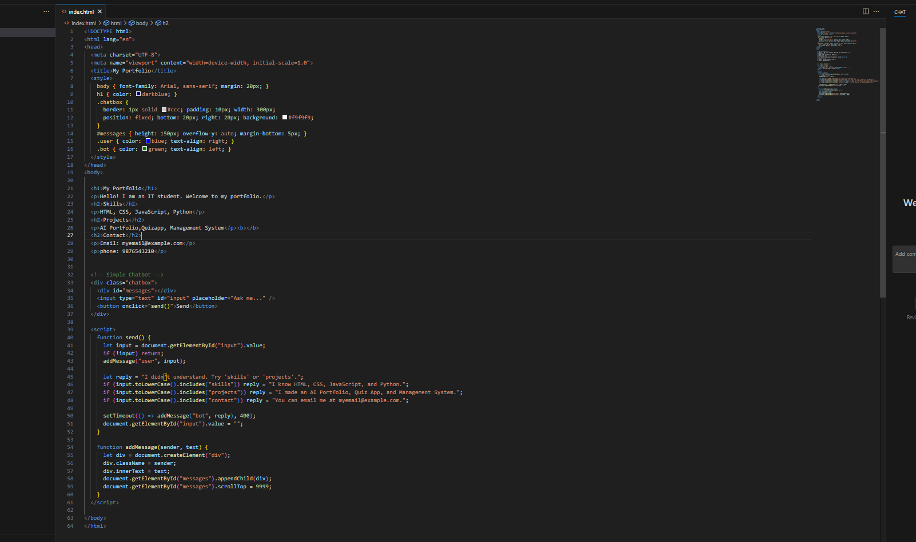
RESULTS AND SCREENSHOTS
11

Slide 12
CONCLUSION
The AI-Powered Portfolio with Chatbot provides an innovative and interactive way to showcase an individual’s skills, education, projects, and contact information. Unlike traditional portfolios that require users to manually explore different sections, this system enhances engagement through a chatbot assistant that instantly answers relevant questions.
By combining modern web technologies (HTML, CSS, JavaScript) with a simple AI/FAQ-based chatbot, the project demonstrates both technical knowledge and creativity. It not only highlights the candidate’s professional profile but also reflects the ability to integrate intelligent, user-friendly solutions into web development.
This project serves as a strong foundation that can be expanded in the future with advanced AI integration (e.g., Dialogflow, Rasa, OpenAI API) to provide more personalized, human-like interactions. Ultimately, the solution helps recruiters, professors, and collaborators access information efficiently, making the portfolio both functional and impressive.
https://mithunraj-creater.github.io/mithunraj/
12

